Slide 1
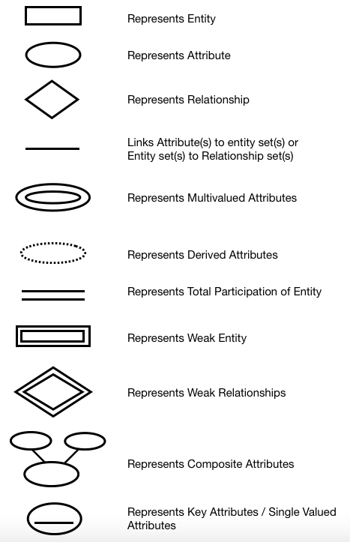
  Attribute’s Symbol

Slide 2
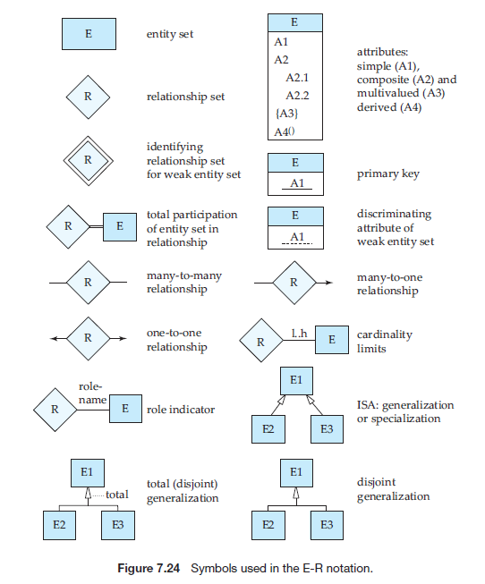

Slide 3
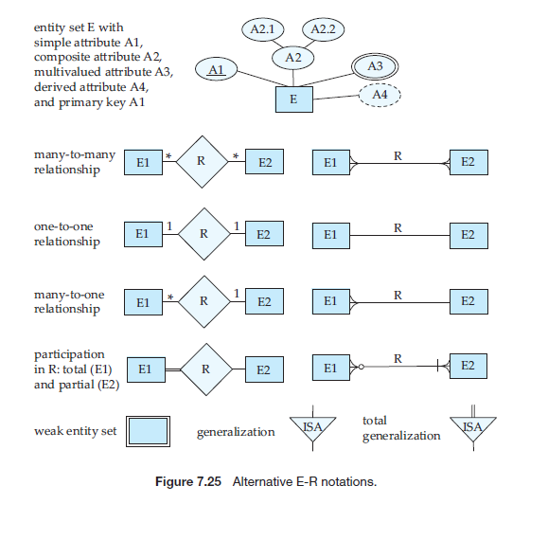

Slide 4
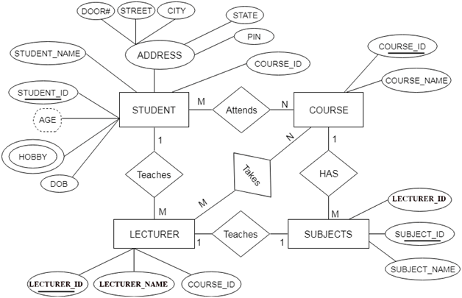
  E-R Model Example 1

Slide 5
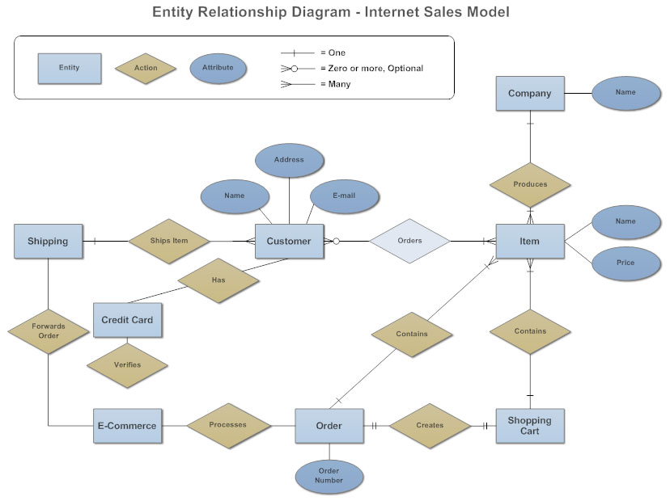
  E-R Model Example 2

Slide 6
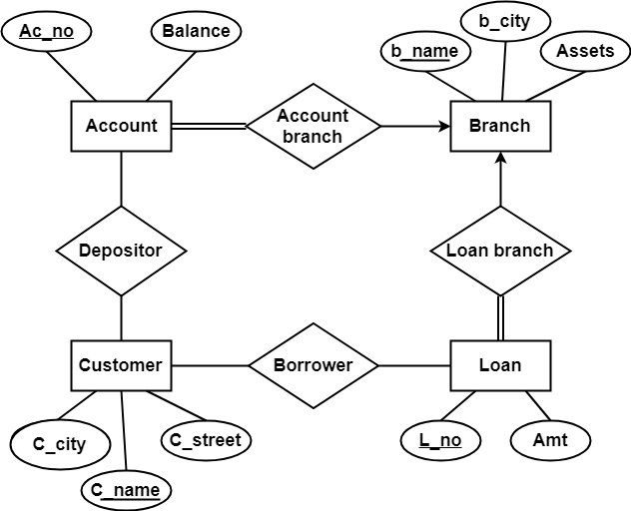
  E-R Model Example 3

Slide 7
EXTENDED E-R FEATURES
The E-R model that is supported with the additional semantic concepts called as extended entity relationship model or EER model.
The EER model includes all the concepts of the original E-R model together with the following additional concepts.
  Specialization
  Generalization
  Attribute inheritance
  Aggregation

Slide 8
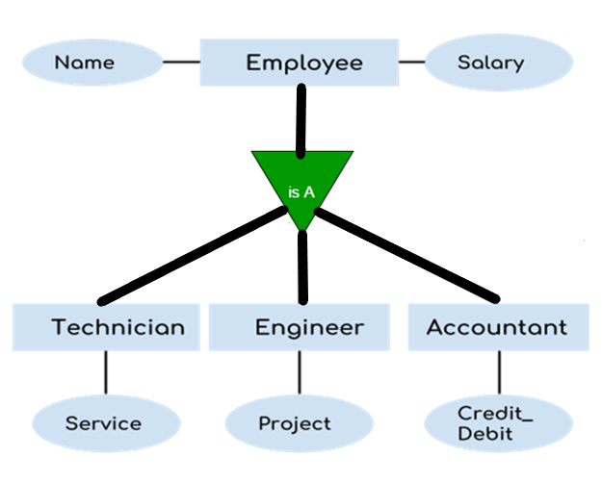
Specialization
  An entity set may include sub grouping of entities that are distinct in some way from other entities in the set.
  The process of designating sub groupings within an entity set is called specialization.
    Ex: Specializations of person allow us to distinguish among persons according to whether they are employee or customers.
  3. Specialization is defined by a triangle component Is A. Is A can also referred as a super class-subclass relationship.

Slide 9
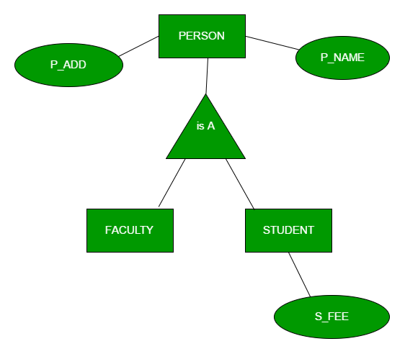
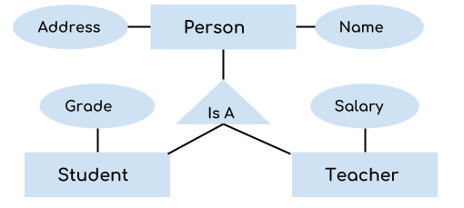
Generalization
Generalization is the process of extracting common properties from a set of entities and create a generalized entity from it.
It is a bottom-up approach in which two or more entities can be generalized to a higher level entity if they have some attributes in common.
For Example, STUDENT and FACULTY can be generalized to a higher level entity called PERSON as shown in Figure.
In this case, common attributes like P_NAME, P_ADD become part of higher entity (PERSON) and specialized attributes like S_FEE become part of specialized entity (STUDENT).

Slide 10
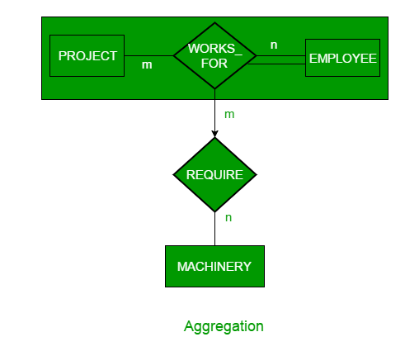
Aggregation
An ER diagram is not capable of representing relationship between an entity and a relationship which may be required in some scenarios.
In those cases, a relationship with its corresponding entities is aggregated into a higher level entity.
For Example, Employee working for a project may require some machinery.
So, REQUIRE relationship is needed between relationship WORKS_FOR and entity MACHINERY.
Using aggregation, WORKS_FOR relationship with its entities EMPLOYEE and PROJECT is aggregated into single entity and relationship REQUIRE is created between aggregated entity and MACHINERY.

Slide 11
Attribute inheritance
  The attributes of higher level entity are said to be inherited by lower level entity set.
  Ex: Customer & employee inherit the attributer of a person.

